Slide 2
Create a home page
Refer to /Django Features and Libraries/week1/cookie_assignment.ppt

Slide 3
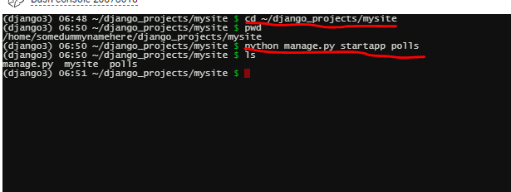
Make dummy1 application
cd ~/django_projects/mysite
workon django3
python manage.py startapp dummy1
Notes:
It will create a new polls folder(bunch of sub directory under polls folder) under mysite directory

Slide 4
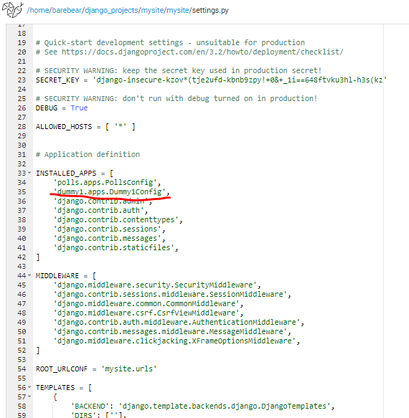
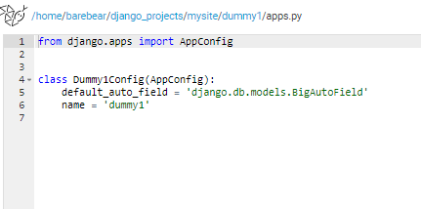
Update in settings.py

Slide 5
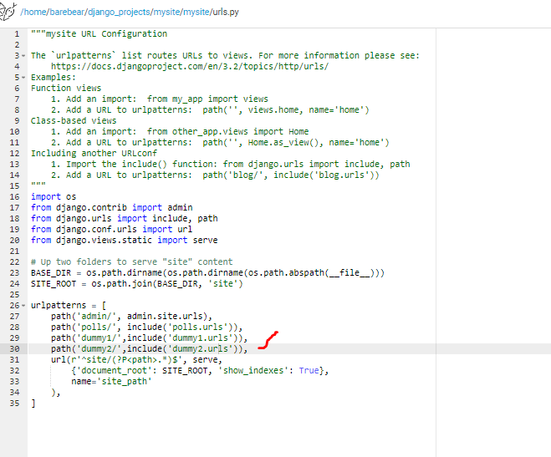
Update mysite/mysite/urls.py

Slide 6
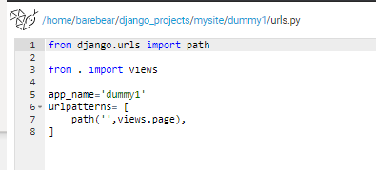
Create urls.py (dummy1/urls.py)

Slide 7
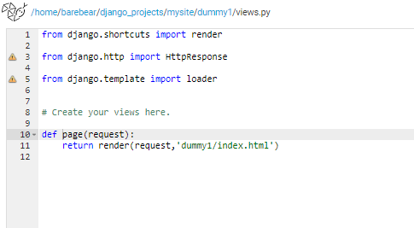
Update dummy1/views.py

Slide 8
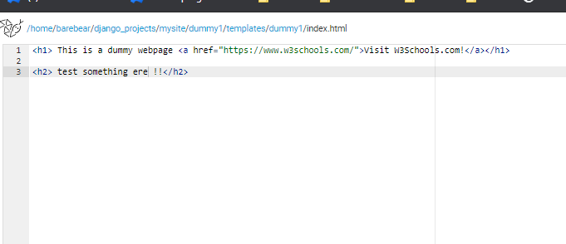
Create templates and html file

Slide 9
Upload and display image
Refer to html_css_javascript/week3/week_buttonWithDivs.ppt

Slide 10
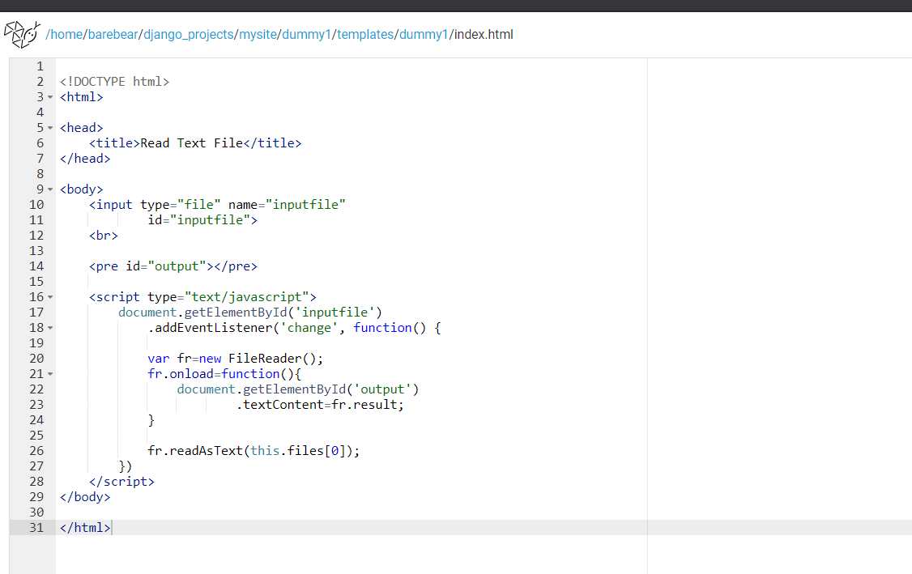
Upload and display text file
Reference link: https://www.geeksforgeeks.org/how-to-read-a-local-text-file-using-javascript/

Slide 11
Reference link
https://www.youtube.com/watch?v=ERMRVORGvZM

Slide 12
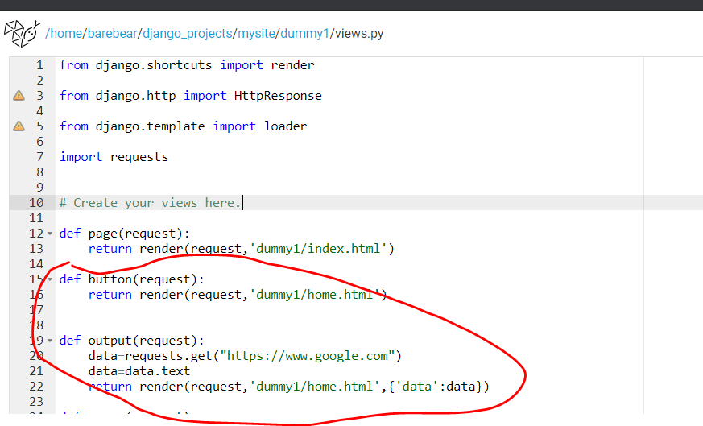
Update views.py
When not clicking button
When clicking button, python script will be executed and pass the result “data” to home.html

Slide 13
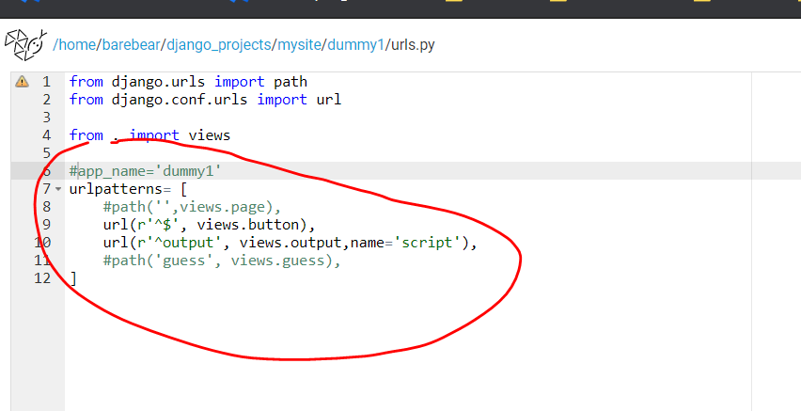
Urls.py

Slide 14
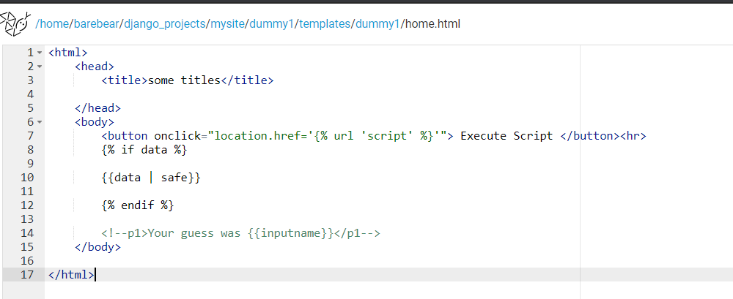
Create/edit html file
Receive data generated in views.py

Slide 15
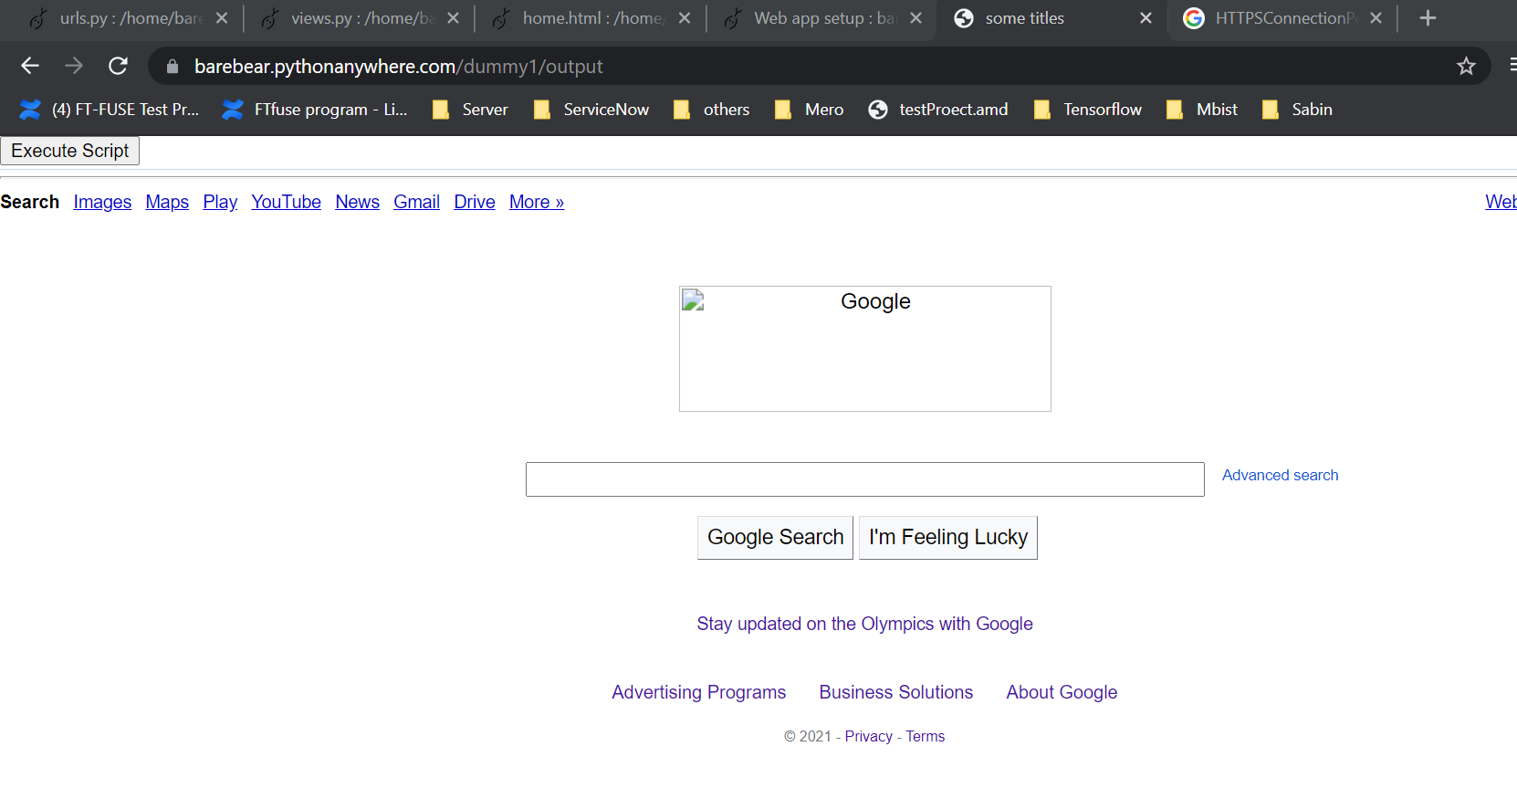
output

Slide 16
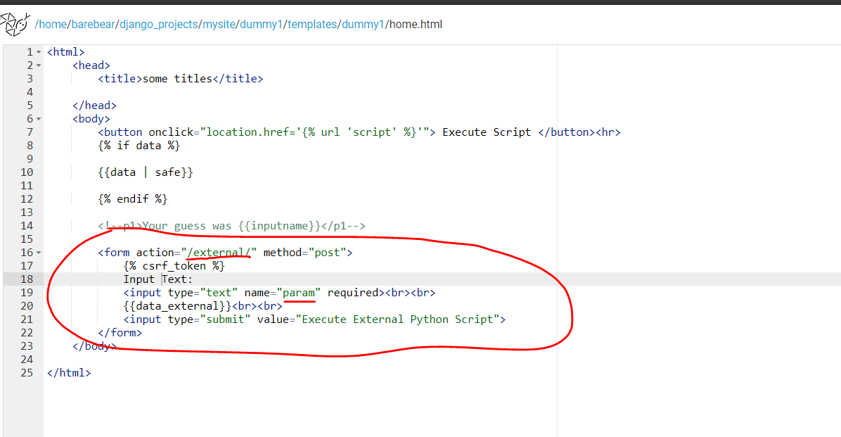
Update html
form

Slide 17
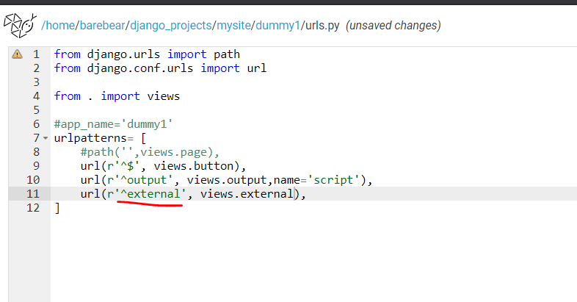
Update urls.py

Slide 18
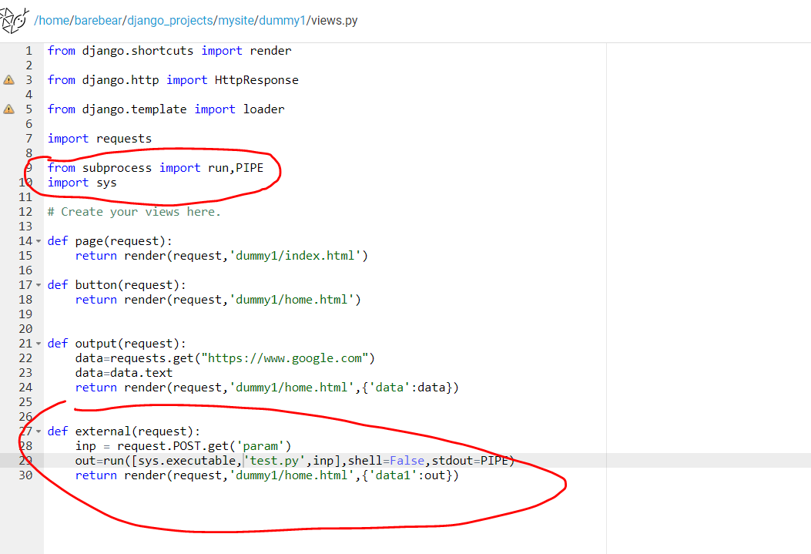
Update views.py
Get the form input
Pass it to test.py script

Slide 19
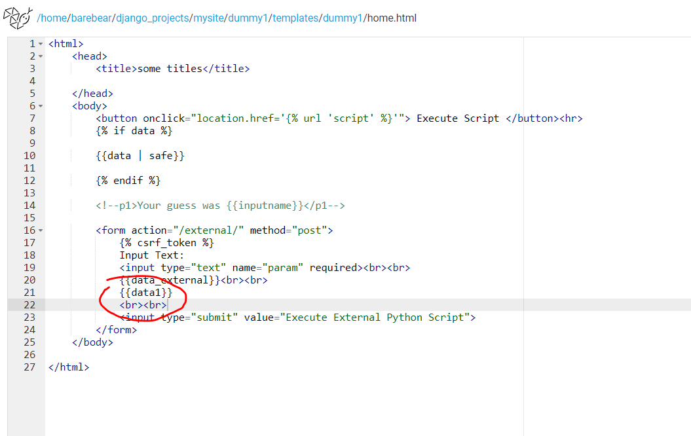
Html

Slide 20
Click Button to upload file to server
https://www.javatpoint.com/django-file-upload

Slide 21
